Slide 1

Module 3: Statistical Analysis and Modelling Linear Regression
Siddharth Sundar
MyAnatomy Integration
NCET Core Team

Slide 2
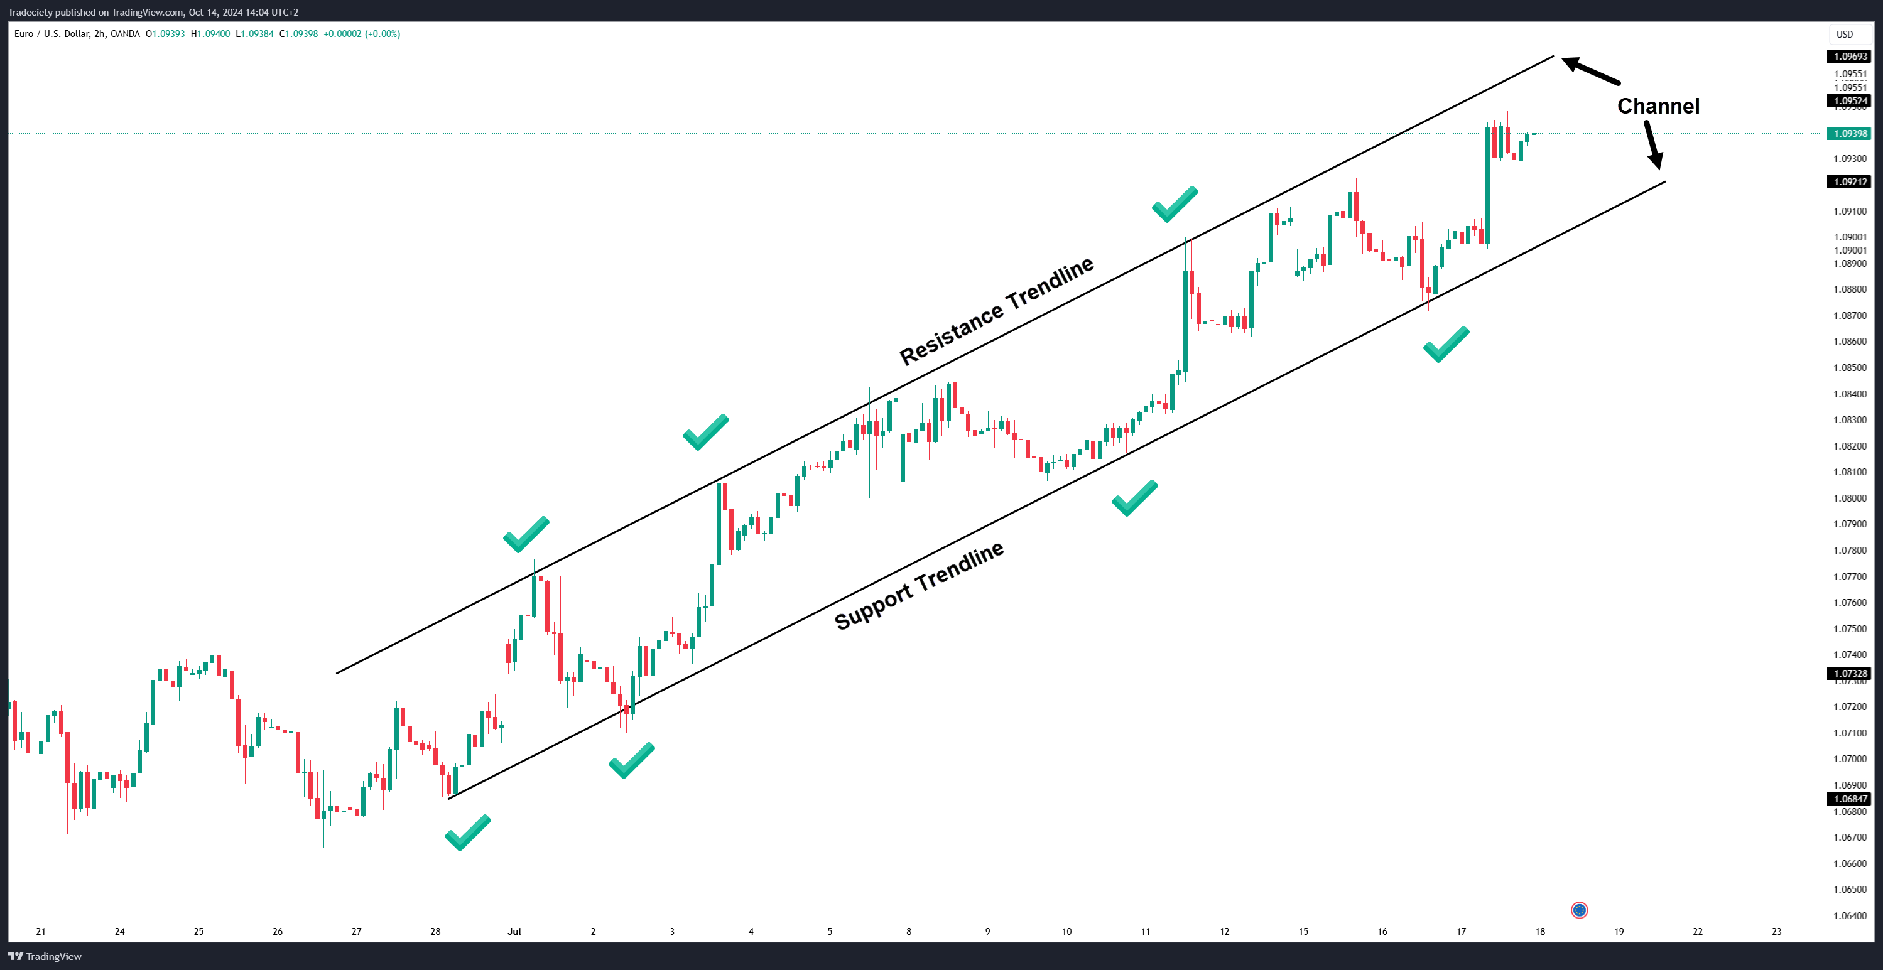
Introduction to Linear Regression
Regression is the statistical method used to model the relationship between a dependent variable and one or more independent variables.
The goal of this particular analysis is to explain the behaviour of the dependent variable, based on the values of the independent variables.
It is EXTREMELY ESSENTIAL to understand Regression as a concept because it helps in different kinds of analytics later on. Also, many models use regression to predict future outcomes.

Slide 3
Linear Regression - Types
There are two primary types of Linear Regression in Applied Statistics.
Simple Linear Regression – When there is one dependent variable and one independent variable.
Multiple Linear Regression – When there is one dependent variable and MULTIPLE independent variables.
The slope function that we were taught in our school days and college days “Y = mX + C” is the regression equation also. Slightly more structured version is “Y= β0 + β1x”

Slide 4
Understanding Linear Regression
So, what does Y= β0 + β1x1 mean?
Y = the value of the dependent variable
β0 = Intercept
β1 = Slope
X1 = Independent Variable 1 Value
Error Term = Margin of error in our statistic model (Similar to Std. Error)
To understand this in the simplest of terms, the equation tells us that what will be the value of Y (Dependent Variable), when there is a change in the value of X by 1 unit (Independent Variable), added with the Slope (the Default Value), and the Error Term (Margin of Error).

Slide 5
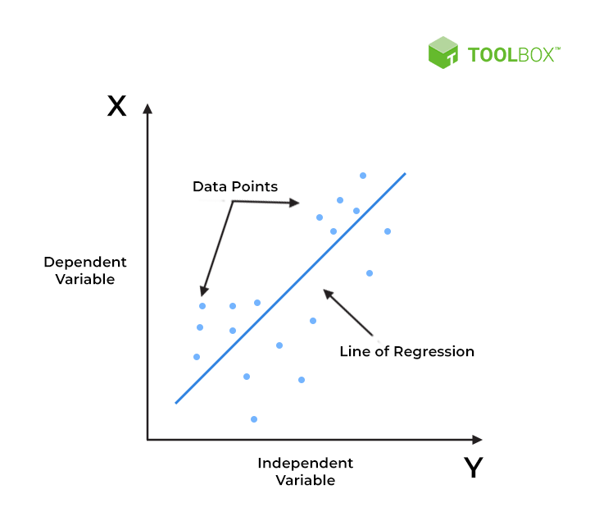
Understanding Linear Regression
Lets look at this graph –
This is a scatter plot with the independent variable on the x axis, and the dependent variable on the y axis. (The image has represented it incorrectly – Source: SciWorks)
The scatter plot shows how the data points are arranged, and there is a CLEAR trend line drawn from between the points.
This line is called the line of regression, and the equation comes from Y=mx+c.

Slide 6
Seems Complicated? Lets break it down even further

Slide 7
Observe the table, Do you notice a Trend?
Advertisement (in 1000s) | Sales
12 | 168711
16 | 162352
19 | 148300
23 | 227776
28 | 272667
31 | 308304
32 | 303861
35 | 347985
37 | 373425
41 | 485801
45 | 446050
46 | 476550
47 | 403644
49 | 440610
51 | 571789

Slide 8
If we plot it on a scatterplot, you can notice a visible trend
Advertisement (in 1000s) | Sales
12 | 168711
16 | 162352
19 | 148300
23 | 227776
28 | 272667
31 | 308304
32 | 303861
35 | 347985
37 | 373425
41 | 485801
45 | 446050
46 | 476550
47 | 403644
49 | 440610
51 | 571789

Slide 9
Lets Take it One Step Further and Draw A Trend Line
Advertisement (in 1000s) | Sales
12 | 168711
16 | 162352
19 | 148300
23 | 227776
28 | 272667
31 | 308304
32 | 303861
35 | 347985
37 | 373425
41 | 485801
45 | 446050
46 | 476550
47 | 403644
49 | 440610
51 | 571789

Slide 10
Now that there’s a straight line, what is its equation?
Advertisement (in 1000s) | Sales
12 | 168711
16 | 162352
19 | 148300
23 | 227776
28 | 272667
31 | 308304
32 | 303861
35 | 347985
37 | 373425
41 | 485801
45 | 446050
46 | 476550
47 | 403644
49 | 440610
51 | 571789

Slide 11
Equation is there, but what is the error term?
Advertisement (in 1000s) | Sales
12 | 168711
16 | 162352
19 | 148300
23 | 227776
28 | 272667
31 | 308304
32 | 303861
35 | 347985
37 | 373425
41 | 485801
45 | 446050
46 | 476550
47 | 403644
49 | 440610
51 | 571789

Slide 12
Lets understand how to do this in Excel

Slide 13
Pay attention to the next set of slides. These are popular interview questions for ANALYST ROLES

Slide 14
Multiple R - Interpreting the Results
Multiple R stands for the “CORRELATION COEFFICIENT”.
It is used to measure the “GOODNESS OF FIT” of a regression model.
A value closer to 1 indicates a STRONG LINEAR RELATIONSHIP.
A value closer to 0 indicates LITTLE or NO LINEAR RELATIONSHIP.

Slide 15
R² - Interpreting the Results
R-Squared stands for the “COEFFICIENT OF DETERMINATION”.
The R-Squared value basically EXPLAINS the variance in the dependent variable, due to the INFLUENCE of the independent variable.
If the R² = 0, model doesn’t explain anything. (Closer to 0)
If the R² = 1, model is a perfect fit.(Closer to 1)

Slide 16
Adjusted R² - Interpreting the Results
Adjusted R-Squared is a measure that ACCOUNTS FOR ADDITIONAL VARIABLES OR RANDOMNESS.
The Adjusted R-Squared value basically tells us, if adding more variables to the equation can help improve the model.
Adjusted R2 helps to identify overfitting of the model.
Higher Adjusted R-Square Value = model is good
Lower Adjusted R-Square Value = model is poor

Slide 17
Intercept- Interpreting the Results
Intercept is the value of the dependent variable (Y), when the value of the independent variable (X) is 0.
For example – Even when there is no advertisement, it is possible that a company makes some minimum amount of sales. That amount is called intercept.
Intercept can be Positive, Negative, or Zero, depending on the data.

Slide 18
Coefficient of X1 (Beta-1) - Interpretation
Beta-1 refers to the slope of the regression line.
It is the value that is multiplied with the INDEPENDENT VARIABLE, to help predict the value of the DEPENDENT VARIABLE.
It basically explains what will be the change in the value of Y with 1-unit change in X.

Slide 19
Predicting the Values
Lets go back to our initial example
Advertisement (in 1000s) | Sales
12 | 168711
16 | 162352
19 | 148300
23 | 227776
28 | 272667
31 | 308304
32 | 303861
35 | 347985
37 | 373425
41 | 485801
45 | 446050
46 | 476550
47 | 403644
49 | 440610
51 | 571789

Slide 20
Predicting the Values
Y = 4958.5 + 9889.5x
So, if I spend 60₹ on Advertisement, the equation will be
Y=4958.5 + 9889.5(60)
= 598328.5
So, if I spend 60,000₹ on Advertisement, I will be earning 598328.5₹ in Revenue.

Slide 21
Predicting the Values – Is it correct?
This calculation is partially complete.
We need to factor in the STD. ERROR as well.
Std. error = 40289.87
Meaning, The predicted value can range between
Upper Bound = 598328.5 + 40289.87
Lower Bound = 598328.5 – 40289.87
Range = 558038.63 to 638618.37

Slide 22
Congratulations, you just learnt how to perform a complete Regression Analysis, and interpret the results in 1 hour.

